Slide 2
Gilligan’s Coconut TV
Jose Rodriguez
Justas Vikonis
Fredrick Birr
Shayne Bloom
Khaja Ameenuddin

Slide 3
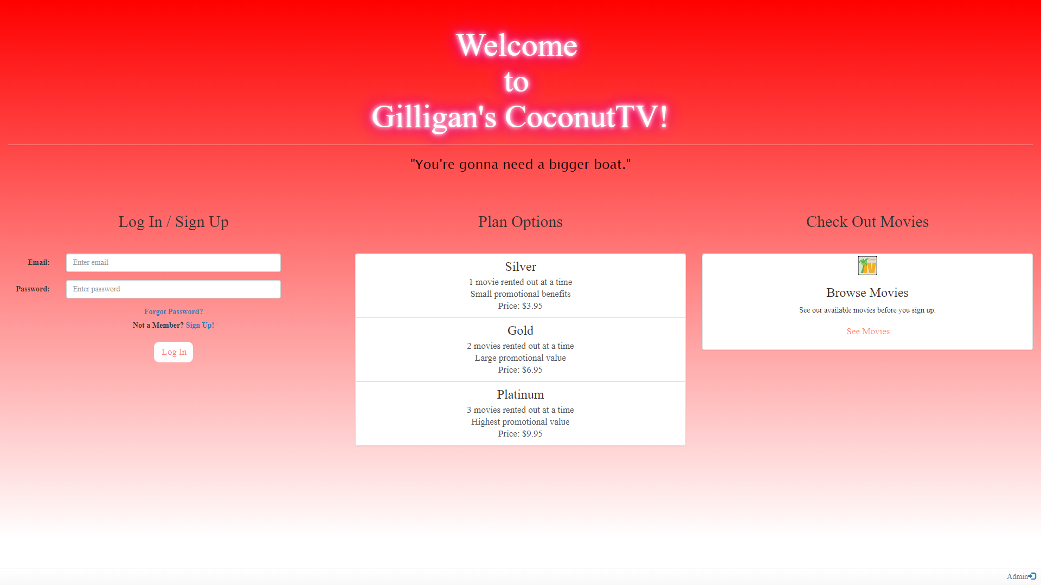

Slide 4
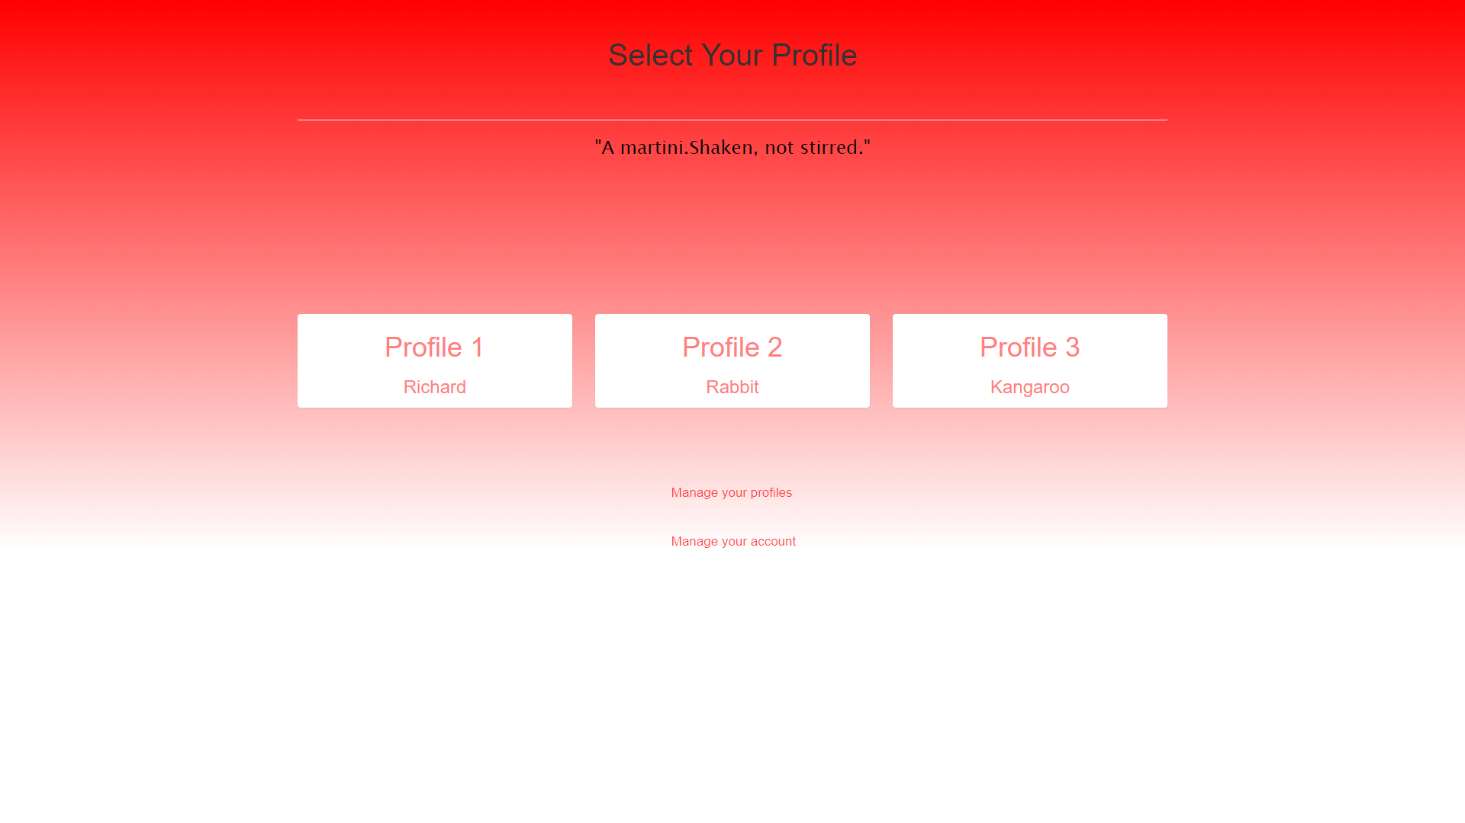

Slide 5
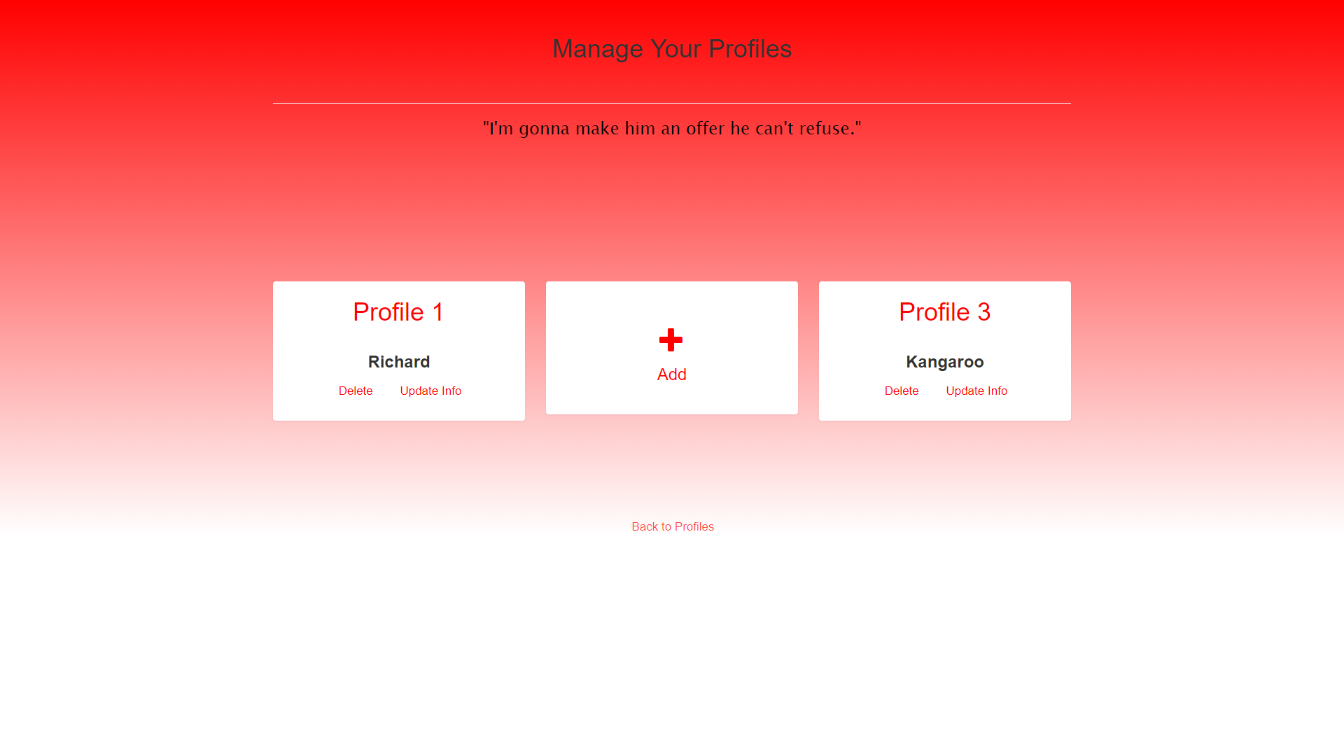

Slide 6
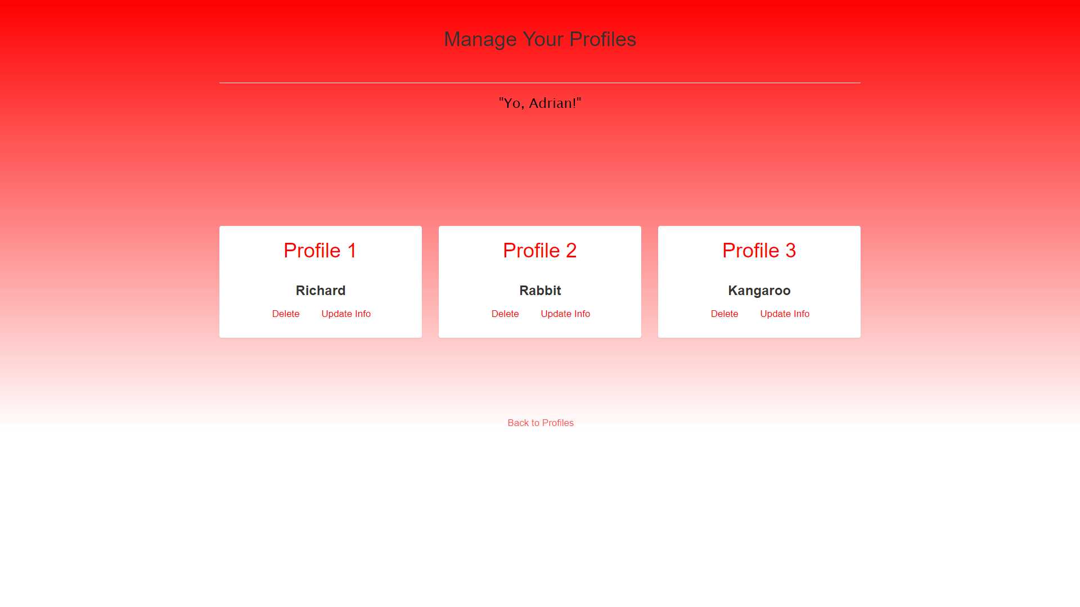
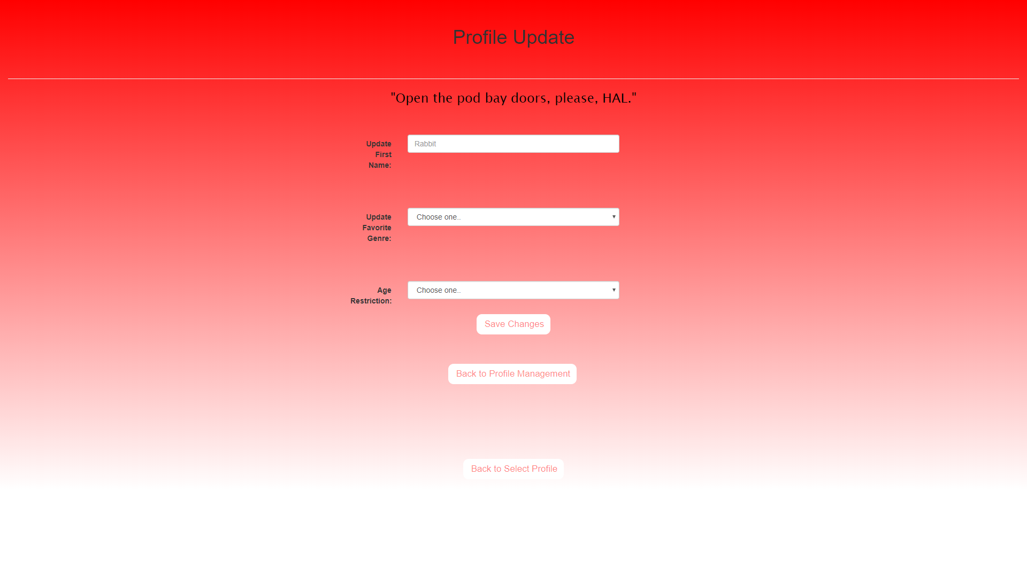

Slide 8
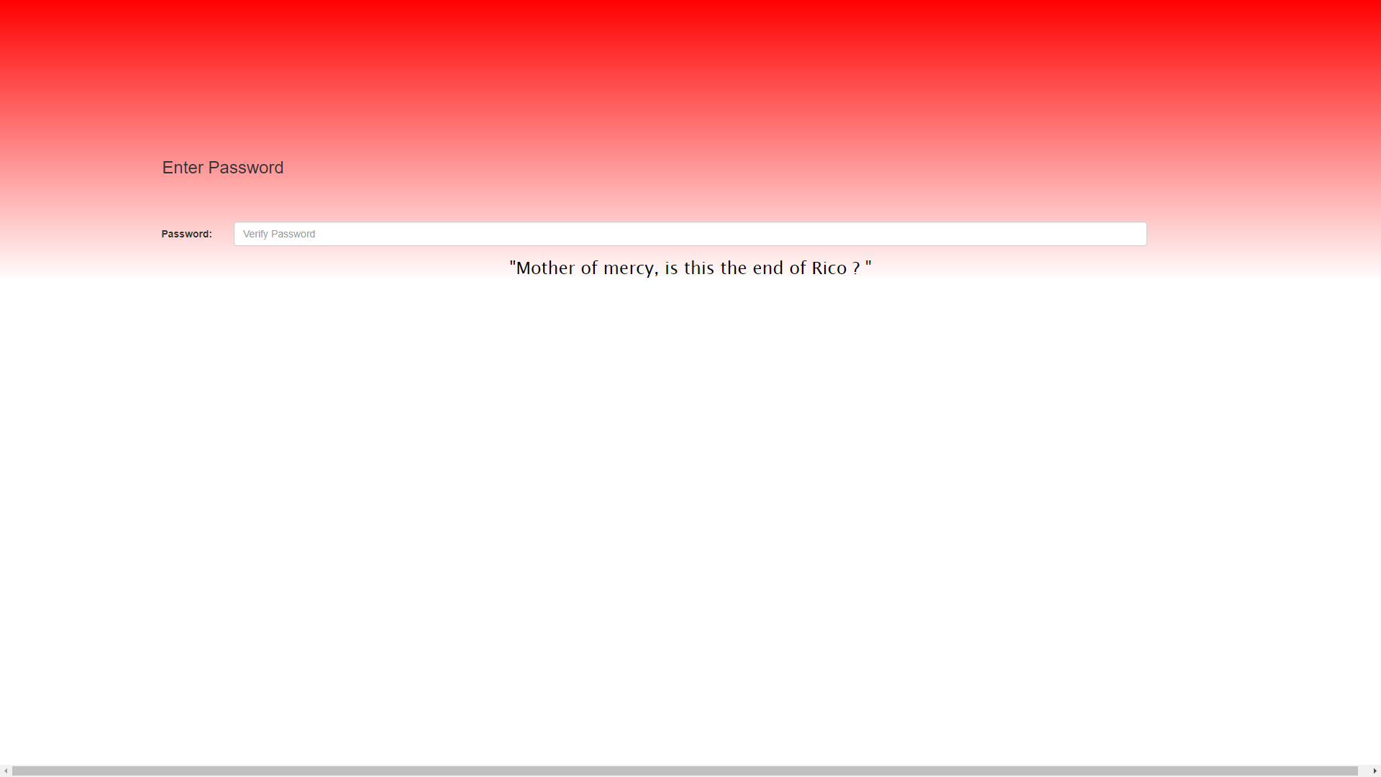

Slide 9
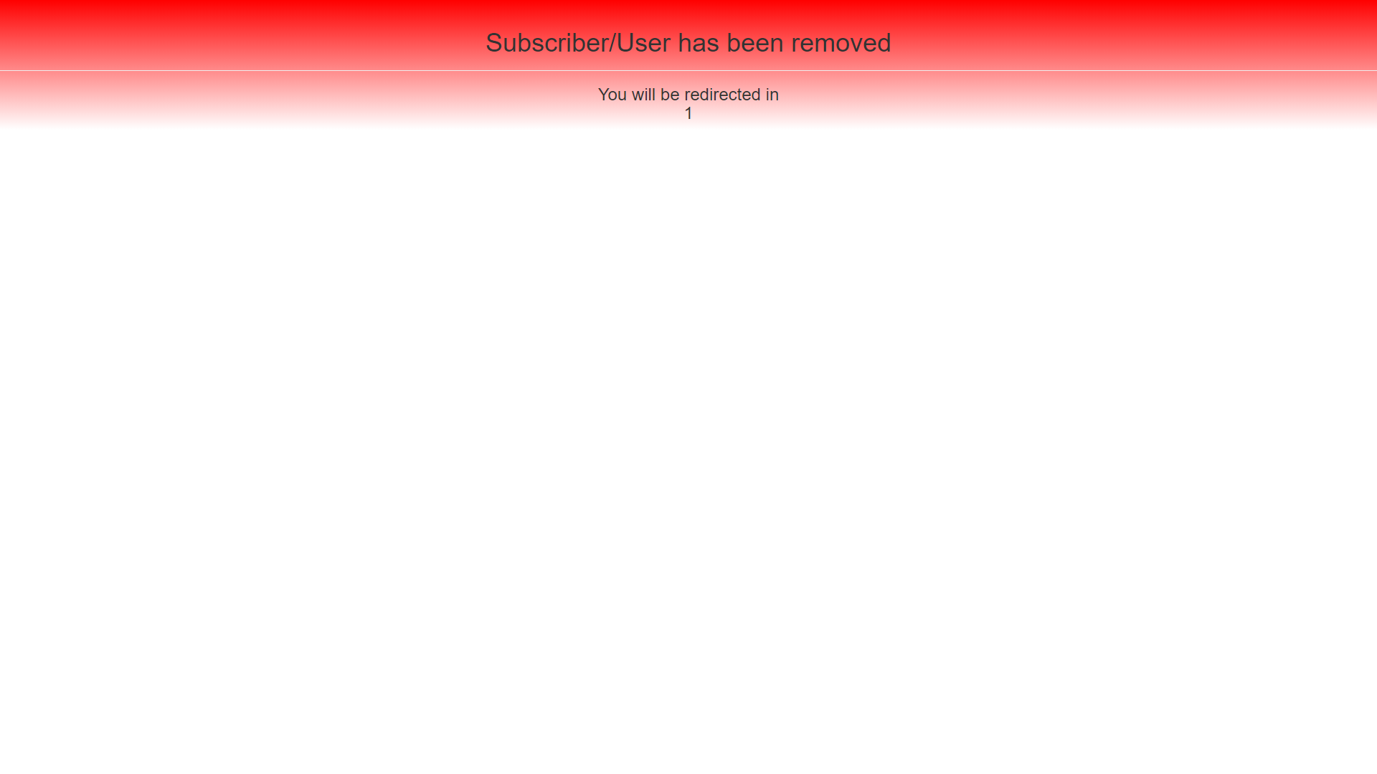

Slide 11
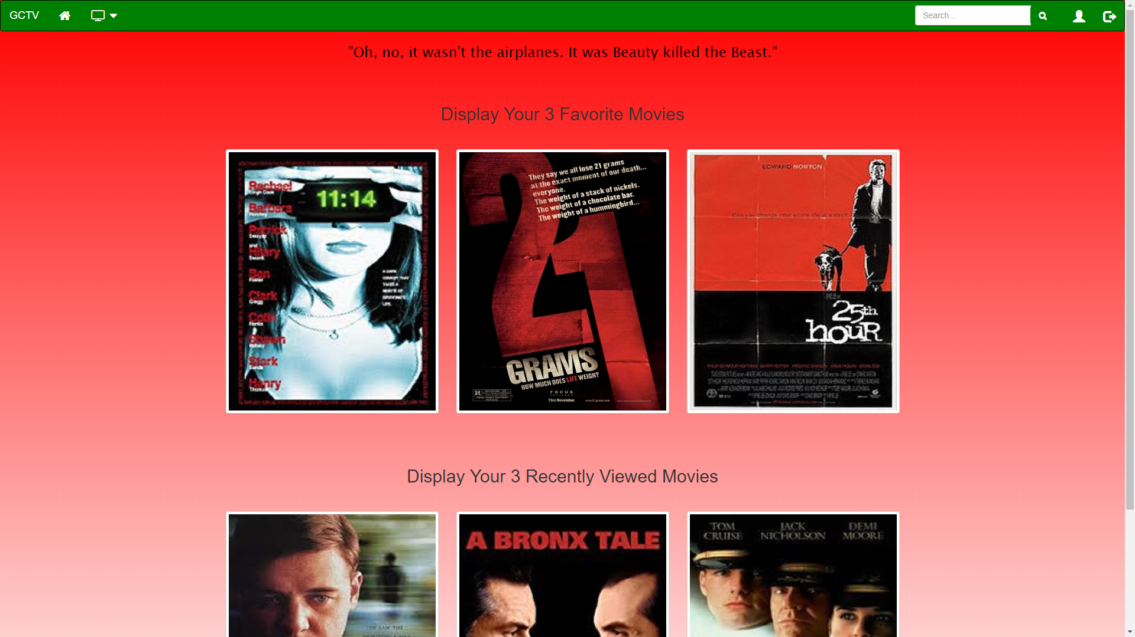

Slide 12
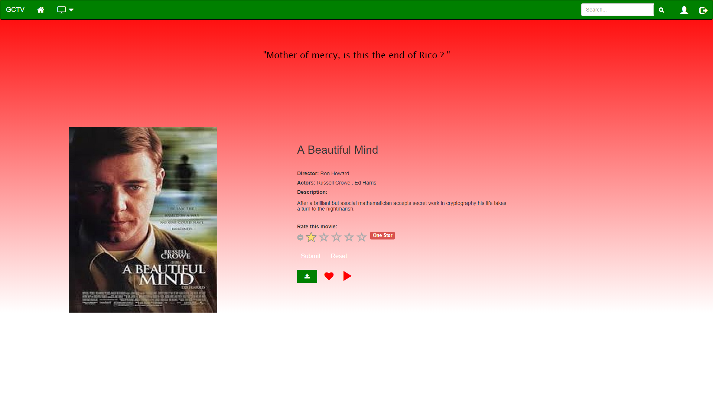

Slide 13
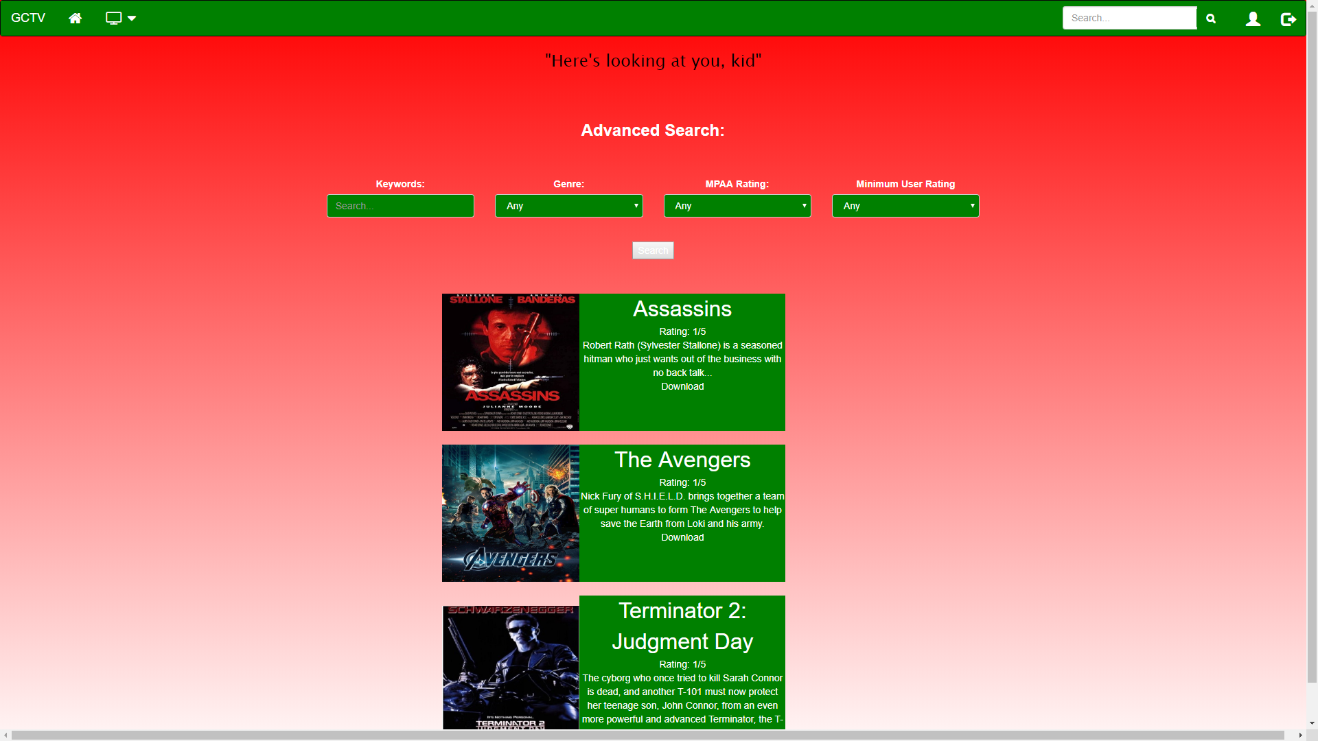

Slide 14
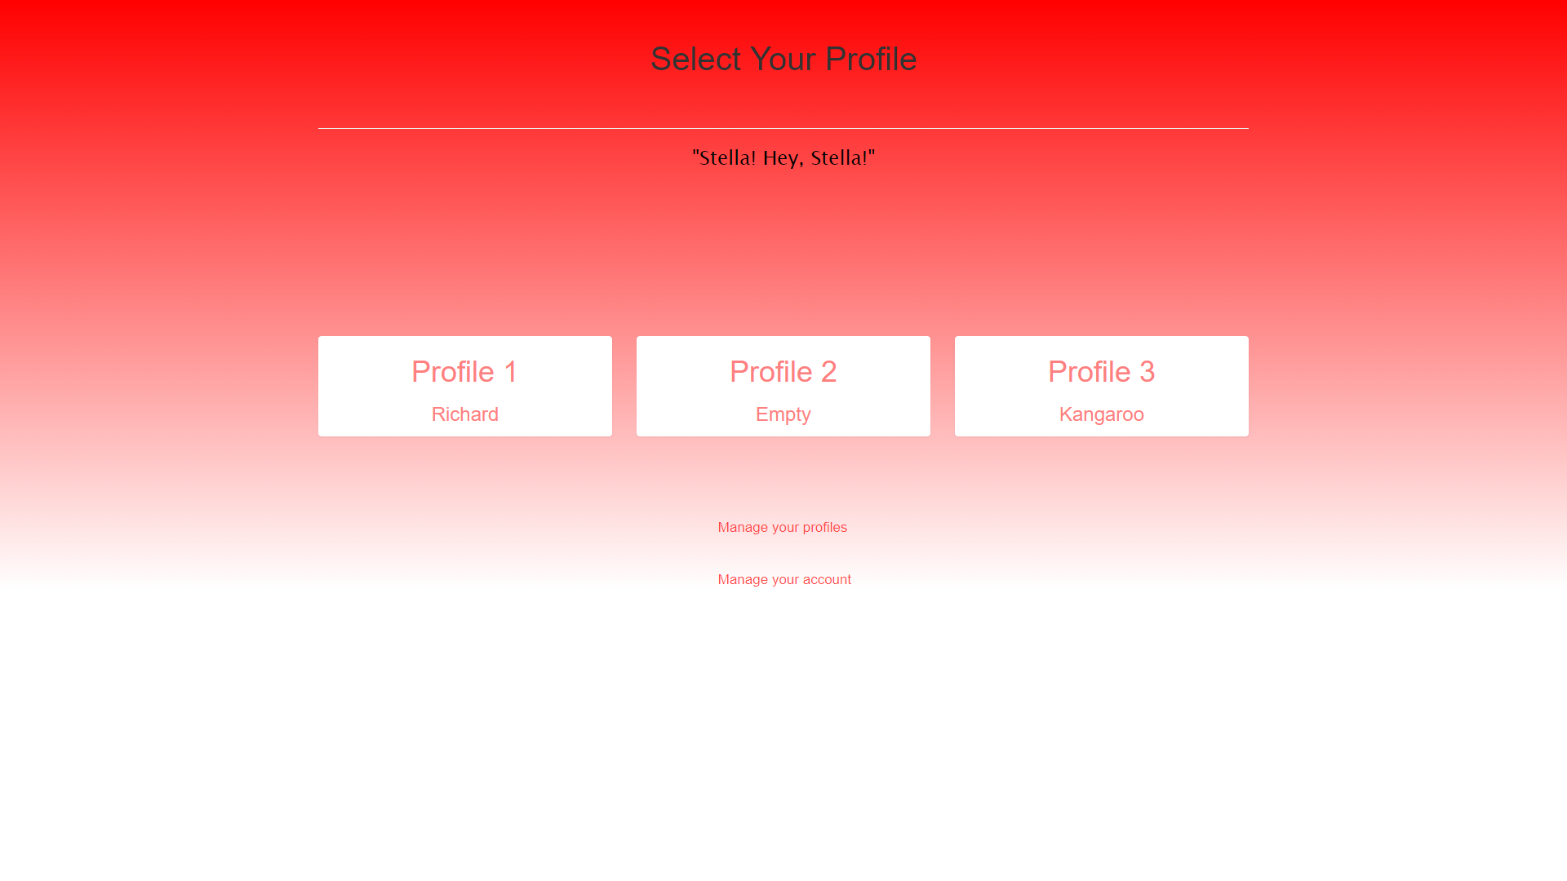

Slide 15
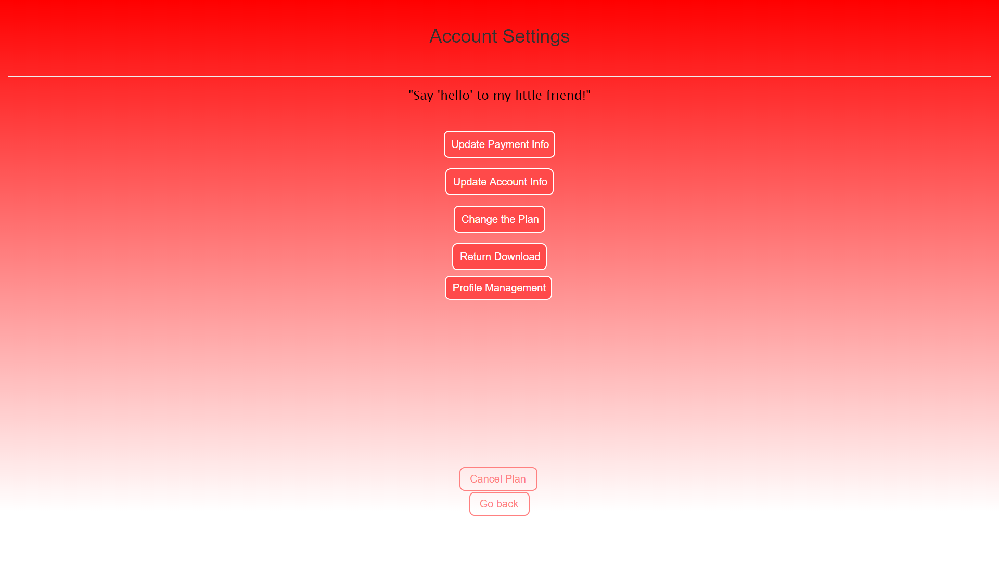

Slide 16
Administrative Tools

Slide 17
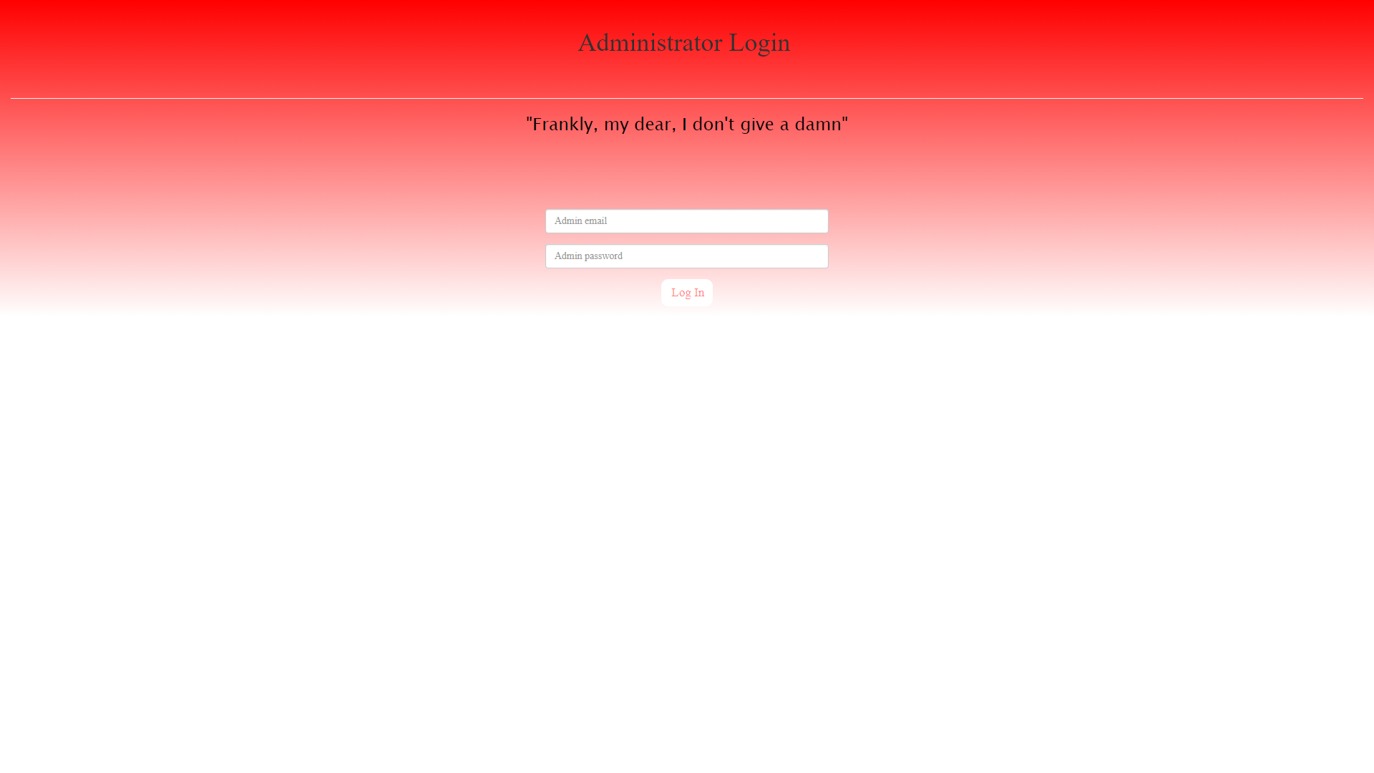

Slide 18
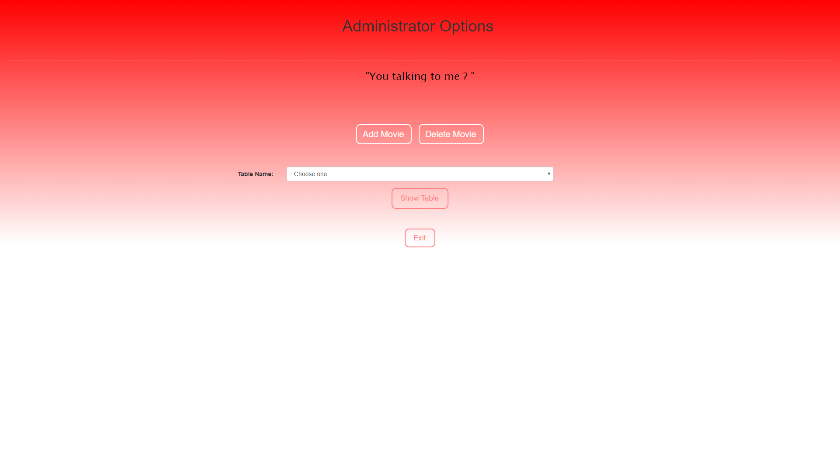

Slide 19
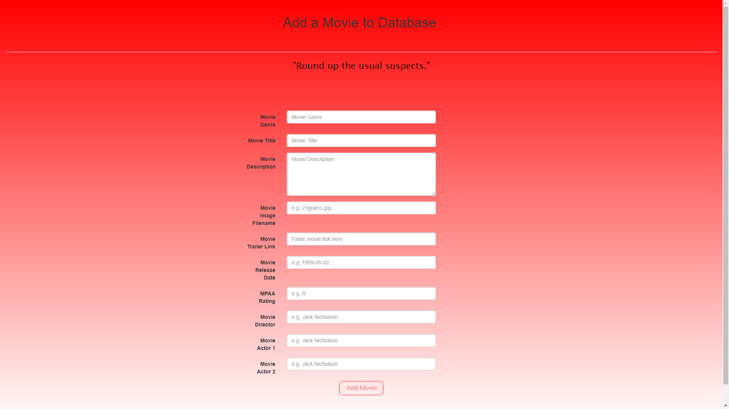

Slide 20
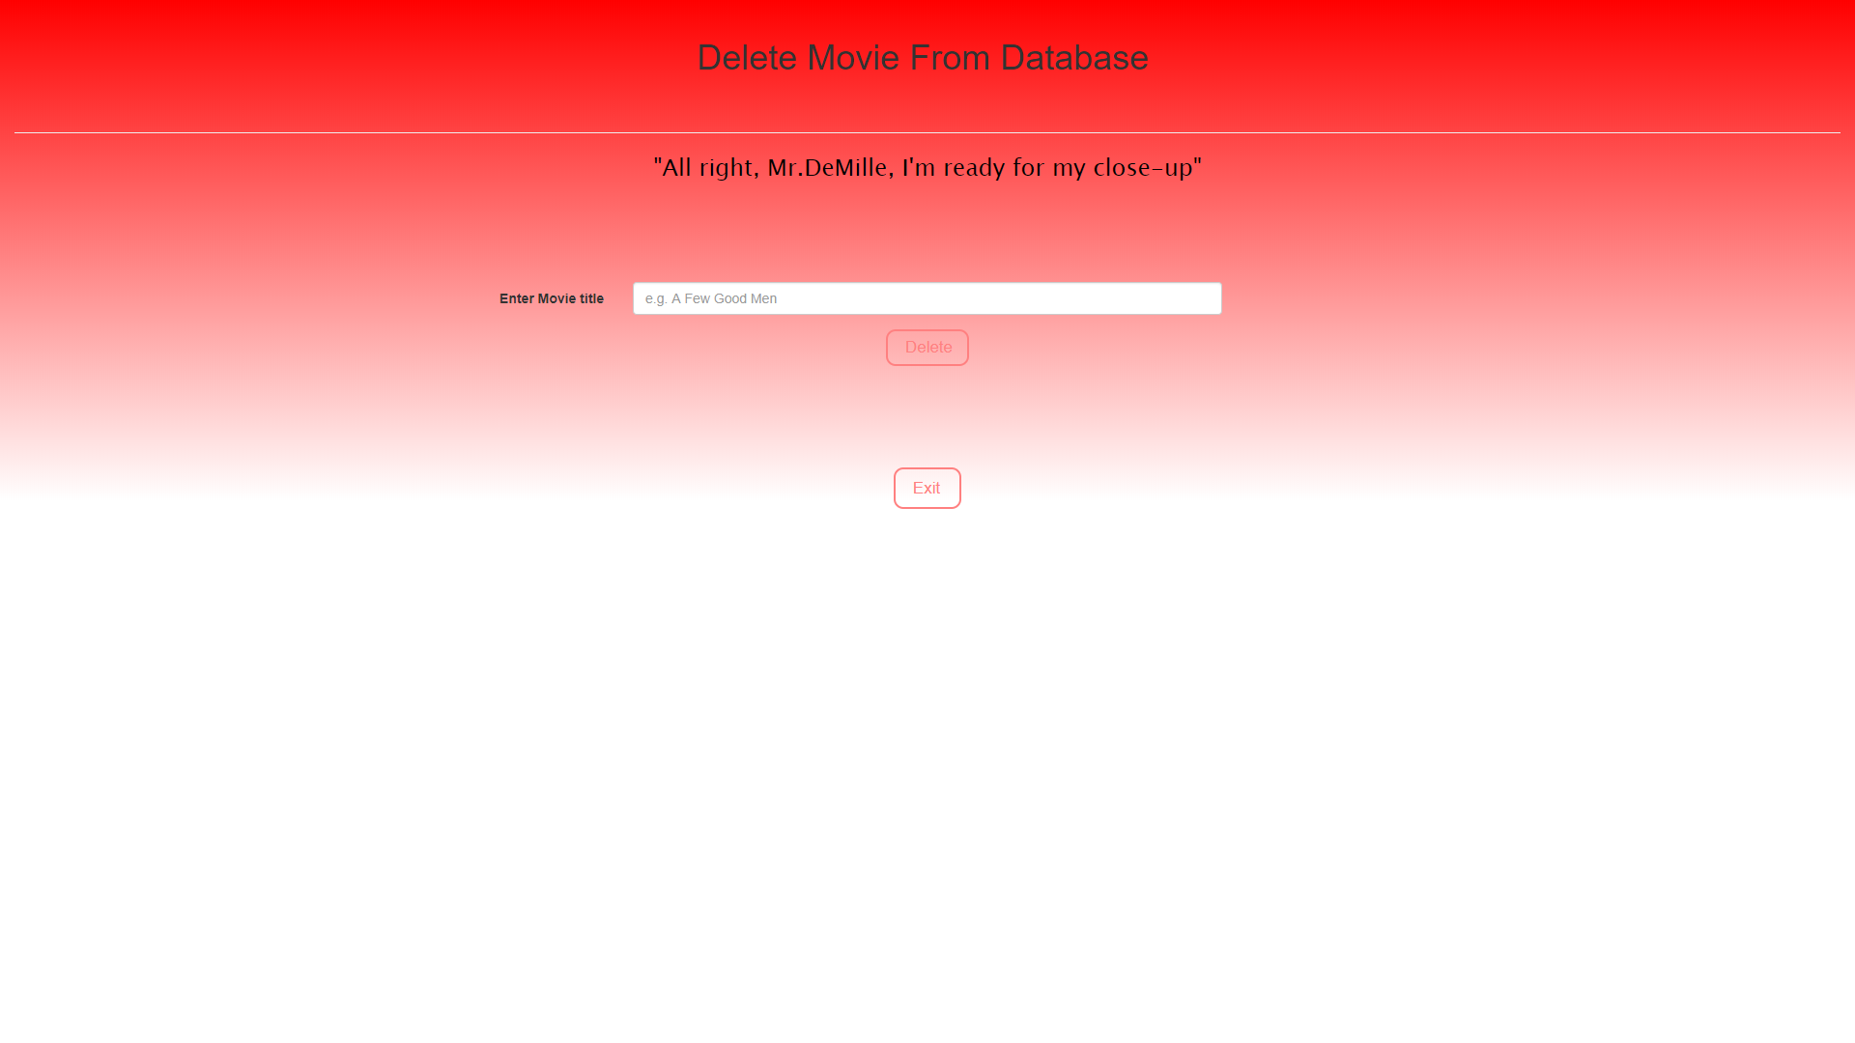

Slide 21
Live Demo

Slide 22
Subscriber Editing Account Information
Scenario 1

Slide 23
Prospective Customer Browsing the Site
Scenario 2

Slide 24
New Customer Signing Up
Scenario 3

Slide 25
Site Map

Slide 26
